Slide 1
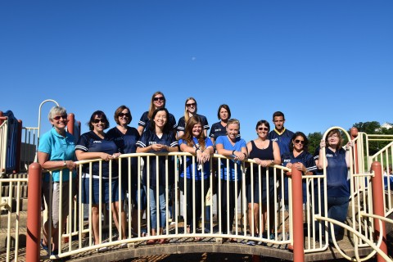
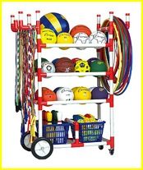
Meet the 2016-2017 Related Arts Team
Notes:
*

Slide 2
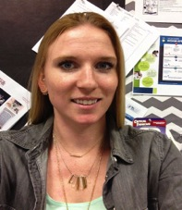
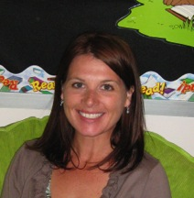
Art
Ms. Murray
Mrs. Frankfurth
Notes:
*

Slide 3
Art Schedule
Kindergarten-- One 45 minute session per week
1st-5th--One hour per week
You might get messy so don’t wear your best clothes on art days ☺
Notes:
*

Slide 4
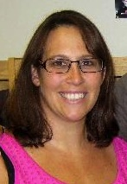
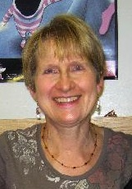
Media Specialists
Mrs. Major
Mrs. Tordella
Notes:
*

Slide 5
Media
Schedule
K-5th
Receive one 45 minute session every week
Please be sure to keep books in a safe place and bring them back each week!
Notes:
*

Slide 6
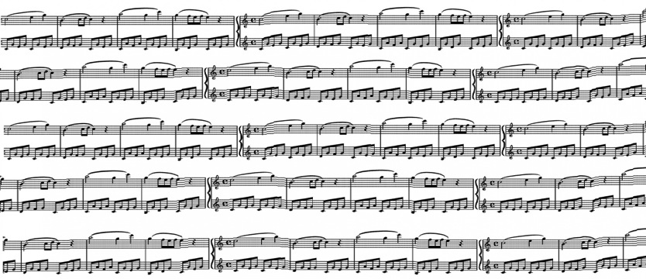
Music
Mrs. Patterson
Ms. Jeon
Notes:
*

Slide 7
Music
Schedule
K-2nd receive two 30 minute classes per week.
3rd-5th receive one hour per week.
Students sing songs, dance, play instruments, and play singing games to learn about beats and rhythm.
Notes:
*

Slide 8
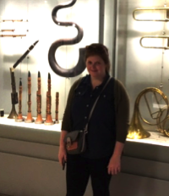
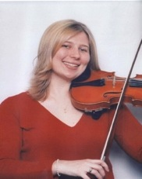
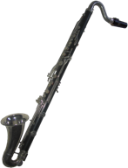
Instrumental Music
Ms. Hogg
Mrs. DeOrio
String instruction is for 3rd, 4th, and 5th graders.
Band instruction is for 4th and 5th graders.
Notes:
*

Slide 9
Instrumental Music
-Band and String (Orchestra) students receive two 30-minute classes per week.
-Students are pulled out of other classes (content, related arts, and recess) in order to attend Instrumental Music classes
-Enrollment deadline was September 9th, but if your student would like to enroll, please email Ms. Hogg (natalie_hogg@hcpss.org) for band or Mrs. De Orio (patricia_deorio@hcpss.org) strings (aka-orchestra) ASAP
Notes:
*

Slide 10
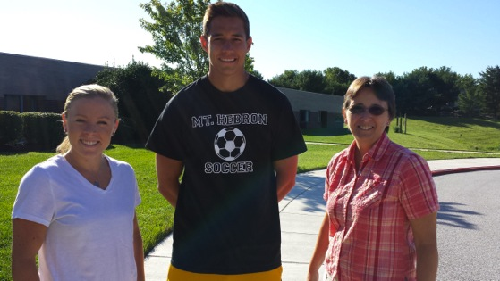
Physical Education
Ms. Borth
Mrs. Goodwin
Mr. Cassard
Notes:
*

Slide 11
P.E. Schedule
All students receive 90 minutes of P.E. each week
Wear sneakers on P.E. days
If your child is unable to participate in P.E. because of injury or illness a note must be sent in.
Notes:
*

Slide 12
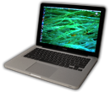
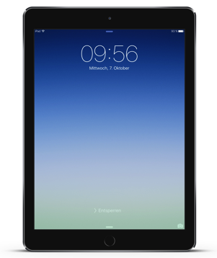
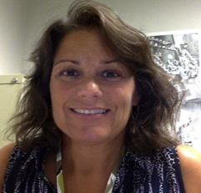
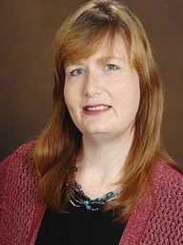
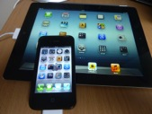
Technology
Mrs. Wise
Mrs. Wise
Ms. Yost
Notes:
*

Slide 13
Technology Info
1 hour of computer instruction per week.
Classes are co-taught with classroom teachers to better correlate with the curriculum!
Students use Macbook laptops, and ipads
Bluetooth earphones are provided in the lab, but students are welcome to bring their own.
http://www.frestechnology.weebly.com
Notes:
*

Slide 14
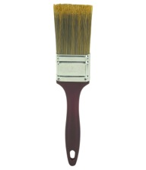
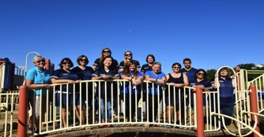
We look forward to working with your children!
Notes:
*

