Slide 1
Forest Ridge Elementary School
Welcome!
Back to School Night

Slide 2
Let’s Introduce the Fourth Grade Team
Dana Caha- Team Leader (ELA/S.S/Math/Science/Heath)
Dan White- Teacher (Math/Science/Health)
Connie Haymon- Teacher (Math/Science/Health)
Jen Jones- Teacher (ELA/Social Studies)
Sheila Dwyer-Teacher (ELA/Social Studies)
Rebecca Jackson- Para Educator
Notes:
Note the names and pronunciations to parents.

Slide 3
The Fabulous Fourth Grade Team’s Specialists
Bailey Green- Special Education teacher
Shari Knudson- Special Education teacher
Barbara Keigler- Esol Teacher
Susan Langley- GT Teacher
Matthew Vaughn Smith- Reading Specialist

Slide 4
Let’s take a look at the schedule…
9:00 – 9:15 Morning Work/Greeting
9:20 – 10:40 Language Arts (AM Block)
10:35 – 11:20 Social Studies (AM Block)
11:20 – 12:20 Related Arts
12:20 – 1:20 Lunch Recess
1:20 – 2:45 Math (PM Block)
2:45 – 3:25 Science/Health (PM Block)
3:30 – 3:45 Dismissal
Notes:
Go over the schedule
Speak to the varied RA schedule
Talk up the super skill of the day and the importance of being to school on time
Be prepared to address the late lunch issue. Do not mention this openly.

Slide 5
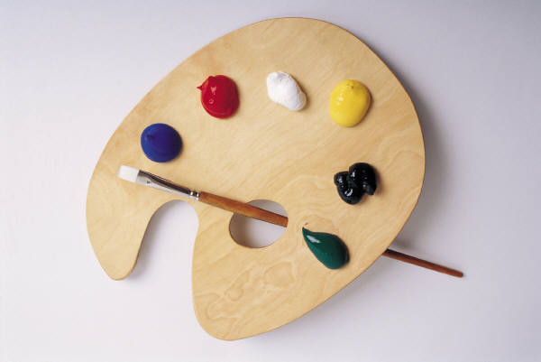
Welcome to Related Arts
Art is very fun! However, it can be very messy. Students, should not wear their finest clothes.
Media is held once a week. We’re thrilled to have lots of new books to share this year. All students will have the opportunity to check out books.
Music is one hour a week. Students should come prepared to move, sing, and play instruments.
In P.E. students should always wear their tennis shoes. No jewelry please. Please send in a note if your student can not participate.
Technology offers our students an opportunity to develop computer literacy skills that they will need to be successful in the future.
*Students can bring their own headphones to leave at school

Slide 6
Mrs. Caha’s Related Arts Schedule
Monday: Media (Tordella)
Tuesday: P.E. (Goodwin)
Technology (Yost)
Wednesday: P.E. (Goodwin)
Thursday: Music (Patterson)
Friday: Art (Murray)

Slide 7
Dress Code - Policy 9210
Attire should be safe and contribute to the learning environment.
Students should:
Wear sneakers on the days they have PE and closed heel shoes on other days (due to recess).
Students should be dressed appropriately for
the weather.
Apply the fingertip rule to any skirts or shorts students
may wear. Tank tops should have a wide top margin.
Make sure no bracelets, necklaces, or earrings are worn on days they have P.E.

Slide 8
PBIS
F: Focus R: Respect E: Effort S:Safety
Together each class created a set of classroom rules.
We use the 1-2-3 Magic method.
Students can earn eagle eggs and save them for rewards.
There is also a classroom incentive

Slide 9
Lunch
Lunch costs $2.75. Milk cost $0.50 (if bought separately)
To pay for lunch, cash can be brought to school or
you can put funds on POS via the HCPSS website. If your child comes in with money, please put it in a plastic bag with their name on it.
Notes:
if you bring more than exact change, put left over change on their account

Slide 10
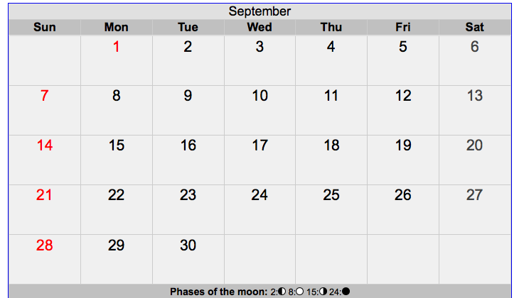
Attendance – Policy 9010
Doors open at 9:00. Parents are required to stop by the office to
receive a tardy slip for their child if they arrive after 9:15.
Students must bring a dated note after returning from an
absence in order for it to be considered a lawful absence.
Students may only make up work if the absence is excused.
Please be aware that any time a student is absent, arrives late, or leaves early, they are missing instruction.

Slide 11
Home Support
Please help your child by:
Ensuring that they get a good night’s sleep every night.
Reading with them on a daily basis. Allow opportunities for you to read to your child and for your child to read to you. Follow up by talking to your child about what was read.
Assisting them with their nightly homework and studying.

Slide 12
What is the homework policy?
Team 4 will follow the HCPSS guidelines for homework. Fourth graders should be completing a total of 40 minutes of homework a night.
Each student will receive homework each night except for Friday. Nightly homework may consist of word study, reading, and/or math. Monday and Wednesday will be math homework. Tuesday and Thursday will be language homework.
Not completing homework can have a significant impact on your child’s academic achievement.
Notes:
This is a good time to go over the spelling homework and reading logs.

Slide 13
Parent Routines
Check “Take home folder” daily
Sign your Child’s agenda book every night.
Read to your child each night
Regular bed times and morning times
Consider packing a healthy lunch
School Supplies- Feel free to donate any supplies to the classroom (tissues, post it notes, dry erase markers, plastic bags, extra pencils, etc. )

Slide 14
Emergency Information
To ensure we can reach you, it is vital
that your child’s emergency information is filled out
and updated throughout the year.
ER Card Link: http://www.hcpss.org/connect/
In the case of an emergency, it is imperative that we know how your child will be getting home if an early dismissal is necessary.

Slide 15
Working Together
Volunteer – take the online course
http://www.hcpss.org/parents/volunteer-information/
Come in to visit
Visit the FRES website
Expect a monthly newsletter
Check your child’s backpack EVERY night!

Slide 16
Field Trips
Walkers Art Museum- November 10th
St. Mary’s City- April
Please be on the lookout for more information about the field trips closer to the dates.

Slide 17
Chick Fila Fundraisers
Oct 18,
Jan 9,
Mar 21,
May 1

Slide 18
Where Can I Get More Information?
Visit Howard County Canvas pages for more information on what your child will learn in all curricular areas.
https://hcpss.instructure.com/courses/34430

Slide 19
Reminders
Label all coats, backpacks, lunchboxes ~
anything you want to be returned, if lost.
Please check your child’s Take Home folder each night. Look for FRES papers on Thursdays.
Please sign your child’s agenda book every night.
Remember to check your child’s lunch account to ensure there are sufficient funds.
Open communication- written note, email, phone call
dana_caha@hcpss.org
410-880-5950

Slide 20
Donations
This year supplies were limited. Therefore, we are asking for your help. Any donations of the following would be greatly appreciated:
Tissues, Tissues, Tissues
Ziploc bags (sandwich and/or gallon)
Wipes
Stamps/Stickers
Additional supplies for your child to keep in his/her extra supply bag (pencils, glue sticks, crayons…)

Slide 21
Communication
Dana_caha@hcpss.org
Sheila_dwyer@hcpss.org
Connie_Haymon@hcpss.org
Rebecca_jackson@hcpss.org
Jennerfer_Jones@hcpss.org
Daniel_White@hcpss.org
School phone number:
410-880-5950

Slide 22
Thank you for attending Back to School Night!
We look forward to a year of collaboration and success!

