Slide 1
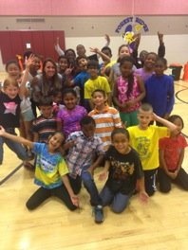
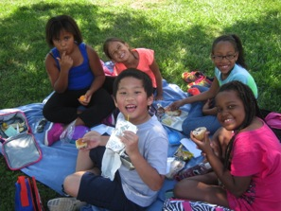
Welcome to
3rd grade!

Slide 2
Let’s meet the 3rd grade team!
Kathy Chrzanowski– Team leader
Joyce Martin- Teacher
Amber Taylor– Teacher
Jim Wright- Teacher
Rachel Winter- Teacher
Barb Warrick- Para-educator
Resource Teachers
Kim Clawson – Math Enrichment
Nikia Darden – Reading Specialist
Estelle Duberry – ESOL Teacher
C’mon Walker – Special Education Teacher
Parris Muse – Special Ed. Para-educator

Slide 3
The 3rd grade team!

Slide 4
Our Schedule
9:00-9:20 Arrival/Announcements
9:20-10:15 Content (Science, SS, Health)
10:15 Snack
10:20-11:20 Related Arts
11:20-12:35 Math
12:35-1:25 Language Arts
1:25-1:55 Lunch
1:55-2:25 Recess
2:25-3:35 Language Arts
3:40 Dismissal

Slide 5
Related Arts Schedule
Mrs. Martin
Monday- Music
Tuesday- PE
Wednesday- Art
Thursday- Technology/PE
Friday- Media

Slide 6
Related Arts Schedule
Mr. Wright
Monday- Art
Tuesday- Music
Wednesday- P.E.
Thursday- Media
Friday- Technology/P.E.

Slide 7
Related Arts Schedule
Ms. Taylor
Monday- P.E.
Tuesday- Technology/P.E.
Wednesday- Art
Thursday- Media
Friday- Music

Slide 8
Related Arts Schedule
Ms. Winter
Monday- Technology/P.E.
Tuesday- Music
Wednesday- Media
Thursday- Art
Friday- P.E.

Slide 9
Related Arts Schedule
Mrs. Chrzanowski
Monday- Music
Tuesday- P.E.
Wednesday- Technology/Media Thursday- P.E.
Friday- Art

Slide 10
Dress Code – Policy 9210
Student should
Wear sneakers on the days they have PE and closed heel shoes on other days (due to recess).
Make sure no bracelets, necklaces, or earrings are worn on days they have P.E.
Apply the fingertip rule to any skirts or shorts students may wear. Tank tops should have a wide top margin.
Students should be dressed appropriately for
the weather.

Slide 11
PBIS
Together each class created a set of classroom rules.
We use the 1-2-3 Magic method.
Students can earn eagle eggs and save them for rewards.
There is also a classroom incentive.

Slide 12
Biowax!
Students will research and write a biographical speech about a person who has made a difference in the world.
Biowax will take place in the spring. Be on the lookout for a set date! ☺

Slide 13
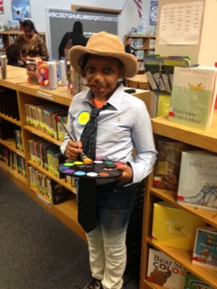
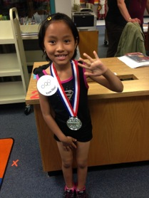
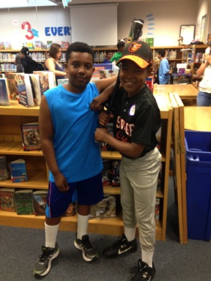
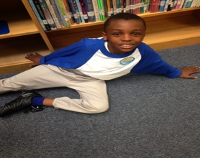
Biowax!

Slide 14
School Store!
During 3rd quarter social studies, students participate in a ‘Money Matters’ unit where they learn about decision making, supply and demand, and creating a budget.
They are then able to apply these skills by creating a team-wide school store. Each class produces different goods and “sells” them to other grades.

Slide 15
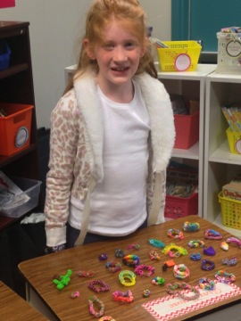
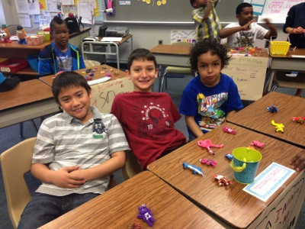
School Store!

Slide 16
Lunch and Snack
Students may bring a small snack each day
Snacks should be healthy, finger foods that can be eaten within 5 minutes
Snacks should be peanut butter/ nut-free due to many student allergies
Examples of appropriate snacks:
Pretzels, goldfish, fruit (pre-cut/peeled), fruit snacks, PLEASE NO DRINK BOXES ☺

Slide 17
Birthday/Food Policy
No birthday treats or invitations can be sent to school with your child (FRES policy).
All food treats must be “nut free”.
If it is a homemade treat, please be very diligent about the allergies (wheat, peanut, tree nut, dairy). It is highly recommended to bring in store bought products.

Slide 18
Report Cards
This year, students will receive letter grades on their report card.
They will continue to receive numbers 1, 2, or 3 for learning behaviors and effort.
Grade percentages goes as follows:
90-100 A
80-89 B
70-79 C
60-69 D

Slide 19
Homework
There will be a homework menu given each quarter.
Spelling words will be sent home biweekly. The words will be glued into your child’s agenda book under the words of the week section.
Homework should take about 20 minutes.
Homework will be completed in their
homework journal

Slide 20
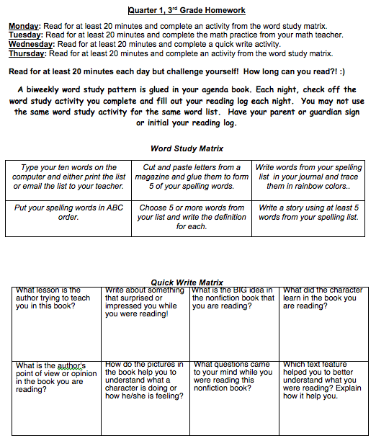

Slide 21
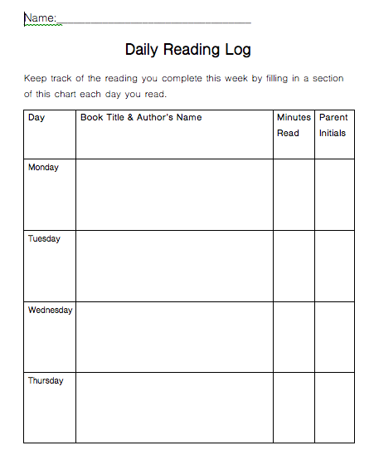

Slide 22
Field Trips
Field trips will be planned for the year and they will be extensions to the curriculum for Science and Social Studies.
At this time, we plan on taking our first field trip to the Maryland Science Center.

Slide 23
Donations
We would greatly appreciate donations of the following items:
Glue sticks!!!
Tissues
Plastic bags (any size)
Hand soap
Black dry erase whiteboard markers

Slide 24
How Can I Support My Child
at Home?
www.hcpss.org
More information about Howard County’s Math Curriculum
Specific grade level standards
Optional activities you can do at home to support your child.
Specific information about curriculum standards can be found: http://www.hcpss.org/academics/what-your-child-will-learn-guides/

Slide 25
Attendance, Early Dismissal
Students are expected to be punctual everyday. The late bell rings at 9:15.
Students should be in their seats ready for learning.
If your child is absent, please send in a note or an email.
If your child requires early dismissal from school, please plan to pick up your child before 3:15.

Slide 26
Emergency Contact Info
Please update your child’s emergency information by going to: www.hcpss.org/connect
Click on: Hcpss Connect Login
If you have an account enter your email and it will take you to your child’s information.
If you do not have an account, you have to activate an account.

Slide 27
Parent Volunteers
In order to volunteer in our school or chaperone on a field trip you MUST complete a volunteer training session.
Please go to the www.fres.hcpss.org website and click on the Parent Volunteer Information.

Slide 28
Helpful Reminders
Label all coats, backpacks, lunchboxes-anything you would want returned if it is misplaced.
Please check your child’s Take Home Folder each night. Look for FRES papers on Thursday.
Please sign your child’s agenda book each night.
Remember to check your child’s lunch account to ensure there are sufficient funds.
Open communication is always best.

Slide 29
Communication
joyce_martin@hcpss.org
james_wright@hcpss.org
katharine_chrzanowski@hcpss.org
rachel_winter@hcpss.org
amber_taylor@hcpss.org
barbara_warrick@hcpss.org
School phone number:
410-880-5950
School website:
http://fres.hcpss.org/

Slide 30
Thank you for attending Back to School Night!
At this time, we will be happy to answer any questions ☺

