Slide 1
Forest Ridge Elementary School
Welcome!
Back to School Night

Slide 2
Second Grade Team
Courtney Smith (LTS Kristin Anzures)- Teacher
Alexis Cramer- Teacher
Katie Leser- Teacher
Michelle Robinson-Teacher
Carol Spaulding- Para Educator
Teresa Walquist-Team Leader
Annie Johnson- Towson Intern
Notes:
Note the names and pronunciations to parents.

Slide 3
Second Grade Team’s Specialists
Jason Cook/Holli Hill- Special Education Teachers
Estella Duberry- Esol Teacher
Kim Clawson- GT Teacher
Matthew Vaughn-Smith- Reading Specialist

Slide 4
Let’s take a look at the schedule…
9:00 - 9:15 Morning Work/Greeting
9:20 -11:20 Language Arts
11:20 -12:20 Recess/Lunch
12:20 - 1:35 Math
1:35 - 2:30 Content
2:30-3:30 Related Arts
3:30-3:55 Dismissal
Notes:
Go over the schedule
Speak to the varied RA schedule
Talk up the super skill of the day and the importance of being to school on time
Be prepared to address the late lunch issue. Do not mention this openly.

Slide 5
Lunch
Lunch costs $2.75. Milk cost $0.50 (if bought separately)
To pay for lunch, cash can be brought to school or
you can put funds on POS via the HCPSS website. If your child comes in with money, please put it in a plastic bag with their name on it.
Notes:
if you bring more than exact change, put left over change on their account

Slide 6
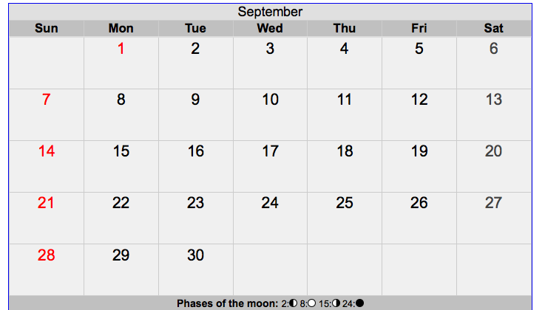
Attendance – Policy 9010
Doors open at 9:00. Parents are required to stop by the office to receive a tardy slip for their child if they arrive after 9:15.
Students must bring a dated note after returning from an
absence in order for it to be considered a lawful absence.
Students may only make up work if the absence is excused.

Slide 7
Emergency Information
To ensure we can reach you, it is vital
that your child’s emergency information is filled out
and updated throughout the year.
In the case of an emergency, it is imperative that we know how your child will be getting home if an early dismissal is necessary.

Slide 8
Homework:
Our formal homework program will begin on Monday Sept.26
Team 2 will follow the HCPSS guidelines for homework. Second graders should be completing a total of 30 minutes of homework a night.
Each student will receive a reading log and a math activity sheet. They should be reading at least 20 minutes a night and practicing their math facts with one of the activities for 10 minutes. Reading logs and math activity sheets should be turned in each week on Friday.
Notes:
This is a good time to go over the spelling homework and reading logs.

Slide 9
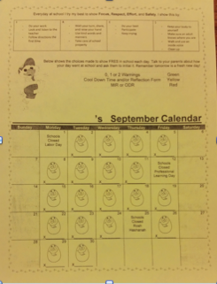
Eagle Egg Calendar
Forest Ridge continues to send home a daily calendar where each student records their behavior for the day.
In order to increase communication between the teacher and parent, the calendar is to be signed and returned each day. This will also be in your child’s Take Home folder every day.

Slide 10
Where Can I Find More Information?
HCPSS CANVAS https://hcpss.instructure.com/courses/34428
OR...
www.hcpss.org
Click on “Academics”
”Mathematics”
“Math Support Center”
“Elementary Math”
“2nd Grade”

Slide 11
Field Trips
Fire Safety House: November
Science Center Visit: What’s the Matter?: December

Slide 12
Attention Parent Volunteers!
If you would like to volunteer please email your child’s teacher with your availability. :)
All volunteers must complete an online module...link is on FRES website: click “Parent Volunteer Information”
http://www.hcpss.org/parents/volunteer-information/
**Only takes about 5 minutes to complete!** :)

Slide 13
Reminders
Label all coats, backpacks, lunchboxes, etc.
Please check your child’s Take Home folder each night. Look for FRES papers on Thursdays.
Eagle Egg Calendar remains inside Take Home Folder.
Remember to check your child’s lunch account to ensure there are sufficient funds.
Open communication- written note, email, phone call
Teresa_Walquist@hcpss.org
410-880-5950

Slide 14
Thank you for attending Back to School Night!
We look forward to a year of collaboration and success!

