Slide 1
Back to School Night Kindergarten 2016

Slide 2
Agenda
A Typical Day
Behavior System
Homework
Field trips
What to Ask Your Child
Going Home
Donations
Classroom Volunteers
Questions
Explore your child’s homeroom

Slide 3
Our Daily Schedule
9:00 Enter Building
9:15 Opening
9:20 Math
10:35 Lunch
11:05 Language Arts
12:40 Snack/Quiet Time/Free Choice/Content
1:25 Specials
2:25 Recess
2:55 Quiet Time/Content
3:30 Dismissal

Slide 4
9:00 Opening
Turn in folder
Math Morning Work
Read the Schedule
Math/Number Routines
Songs / Dance

Slide 5
Math 9:20
Curriculum and resources are located on www.hcpss.org under Academics
Mathematics
Math Support Center
Elementary Math
Kindergarten
Students will be taught in their homerooms in large and small groups. Our goal is to meet the needs of each individual student.
Follow the CANVAS link:
https://hcpss.instructure.com/courses/34447

Slide 6
Buying Lunch
To set up your payment account, you will need your student’s ID number.
Online program fee $2.25
Lunch - $2.75
Milk - $ .50
Children are responsible for any money they bring. Change is not given in the cafeteria. We encourage you to set up an account for lunch buyers!
http://www.hcpss.org/

Slide 7
Lunch 10:35
Assigned tables in the cafeteria
Please pack healthy lunches
Orderly clean up and exit
Students have plenty of time to eat, please encourage your child to use their time wisely.

Slide 8
Language Arts
Students are grouped by ability within their homeroom to best meet their individual needs
Flexible grouping
View www.hcpss.org to see our curriculum and additional resources under:
Academics
English/Language Arts
Support Site for Grades K-5
Primary (Grades K-2)
Follow the CANVAS link:
https://hcpss.instructure.com/courses/34447

Slide 9
Science/Social Studies/Health
Scientists and Engineers, Weather, Pushes and Pulls, Relationships in Ecosystems
Home and School, Maps and Me, Road Trip USA, The Market
Social and Emotional Health, Nutrition and Fitness, Safety-First Aid and Injury Prevention, Disease Prevention and Control

Slide 10
Choice Time
Our favorite time!
A chance for learning how to get along with one another
A chance for the teachers to informally instruct both socially and academically

Slide 11
Snack
Please alert us immediately of any allergies to food or dietary restrictions.
PLEASE PACK A SNACK FOR YOUR CHILD EACH DAY.
Snack should be healthy. (fruit, goldfish, pretzels, graham crackers, etc.)
NO NUT PRODUCTS - We have a life-threatening allergy.
No juice boxes or drinks.
Place snack in a small labeled Ziploc bag.
Do not place in lunchbox.
No utensils will be provided.
Your child should be able to eat snack independently. (Practice opening containers and cleaning up.)

Slide 12
Quiet Time
Please make sure your child has a small towel or blanket.
Blankets will be sent home periodically to be cleaned.
This is a bathroom and drink break too.

Slide 13
1:25 Specials
Physical Education
WEAR TENNIS SHOES on Tuesday, Thursday, and Friday!
Art
Music
Technology
Media
RETURN book each Monday!

Slide 14
Recess 2:25
Please wear appropriate clothing and shoes.
We try to go out as often as we can, even if it is cold.
PLEASE LABEL your jackets, gloves, and hats.

Slide 15
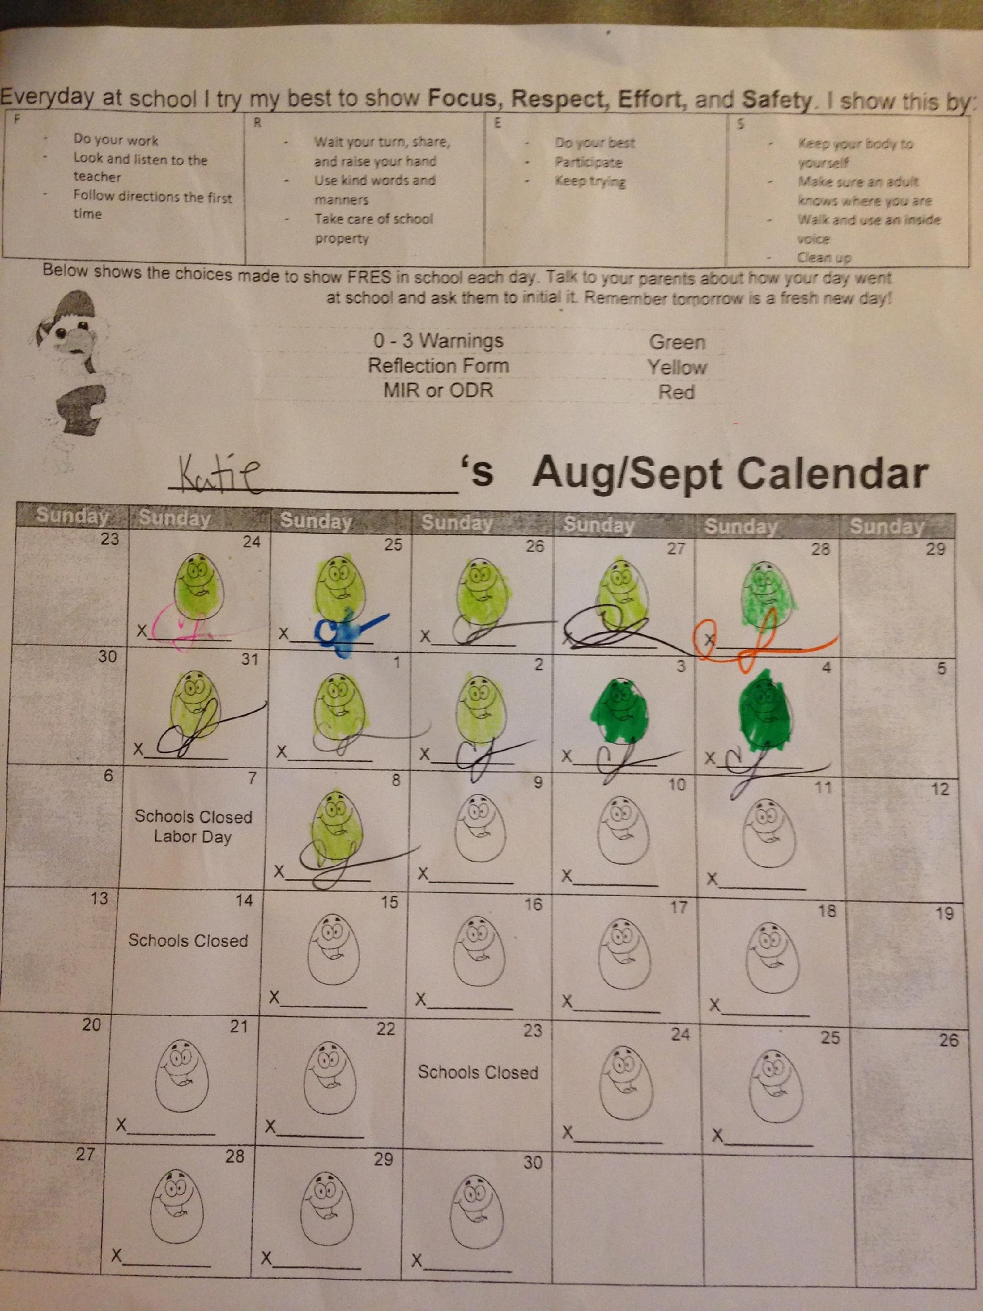
1 - 2 – 3 Magic!

Slide 16
LOOK FOR EAGLE EGGS!
FOCUS
RESPECT EFFORT SAFETY
Praise your children when they come home with Eagle Eggs!

Slide 17
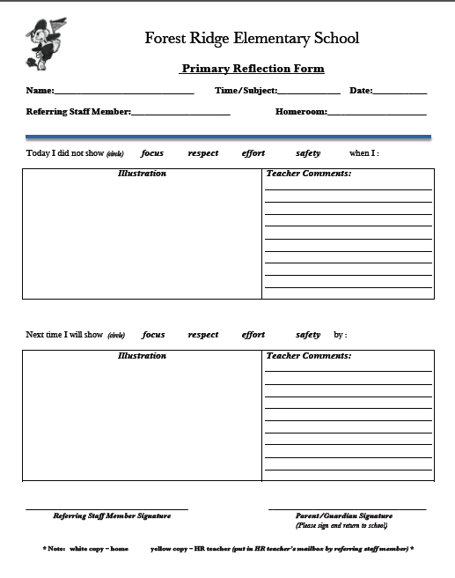
Reflection Form
Please discuss with child at home, focusing on how they plan to act in the future.
Sign and return.

Slide 18
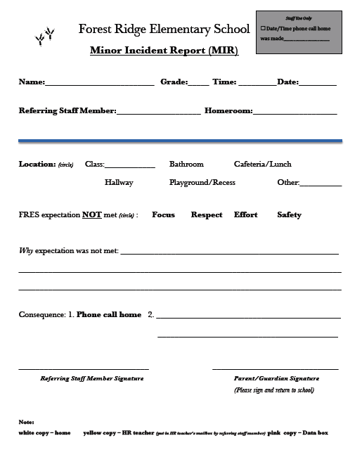
MIR
Minor Incident Report
Given when student has had repeatedly misbehaved.
Given when student’s behavior is more severe.
Copy Is kept for data in school, not in child’s permanent records.
Please sign and return the next day.

Slide 19
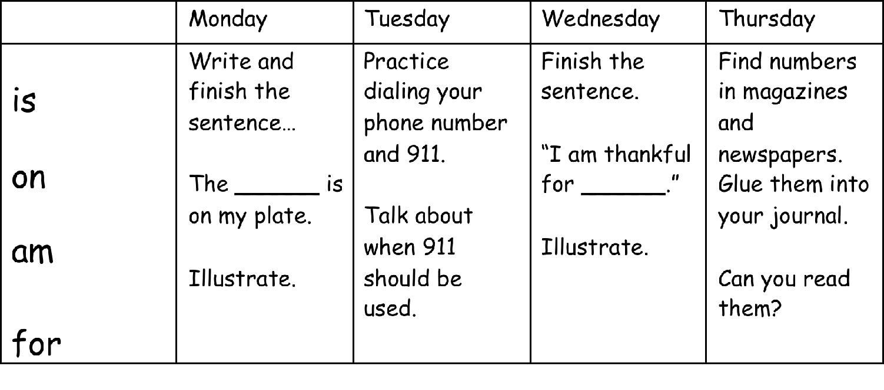
Homework
Homework will be in a journal.
It will come home on Monday and be returned on Friday.
Sight words will be included in the journal.

Slide 20
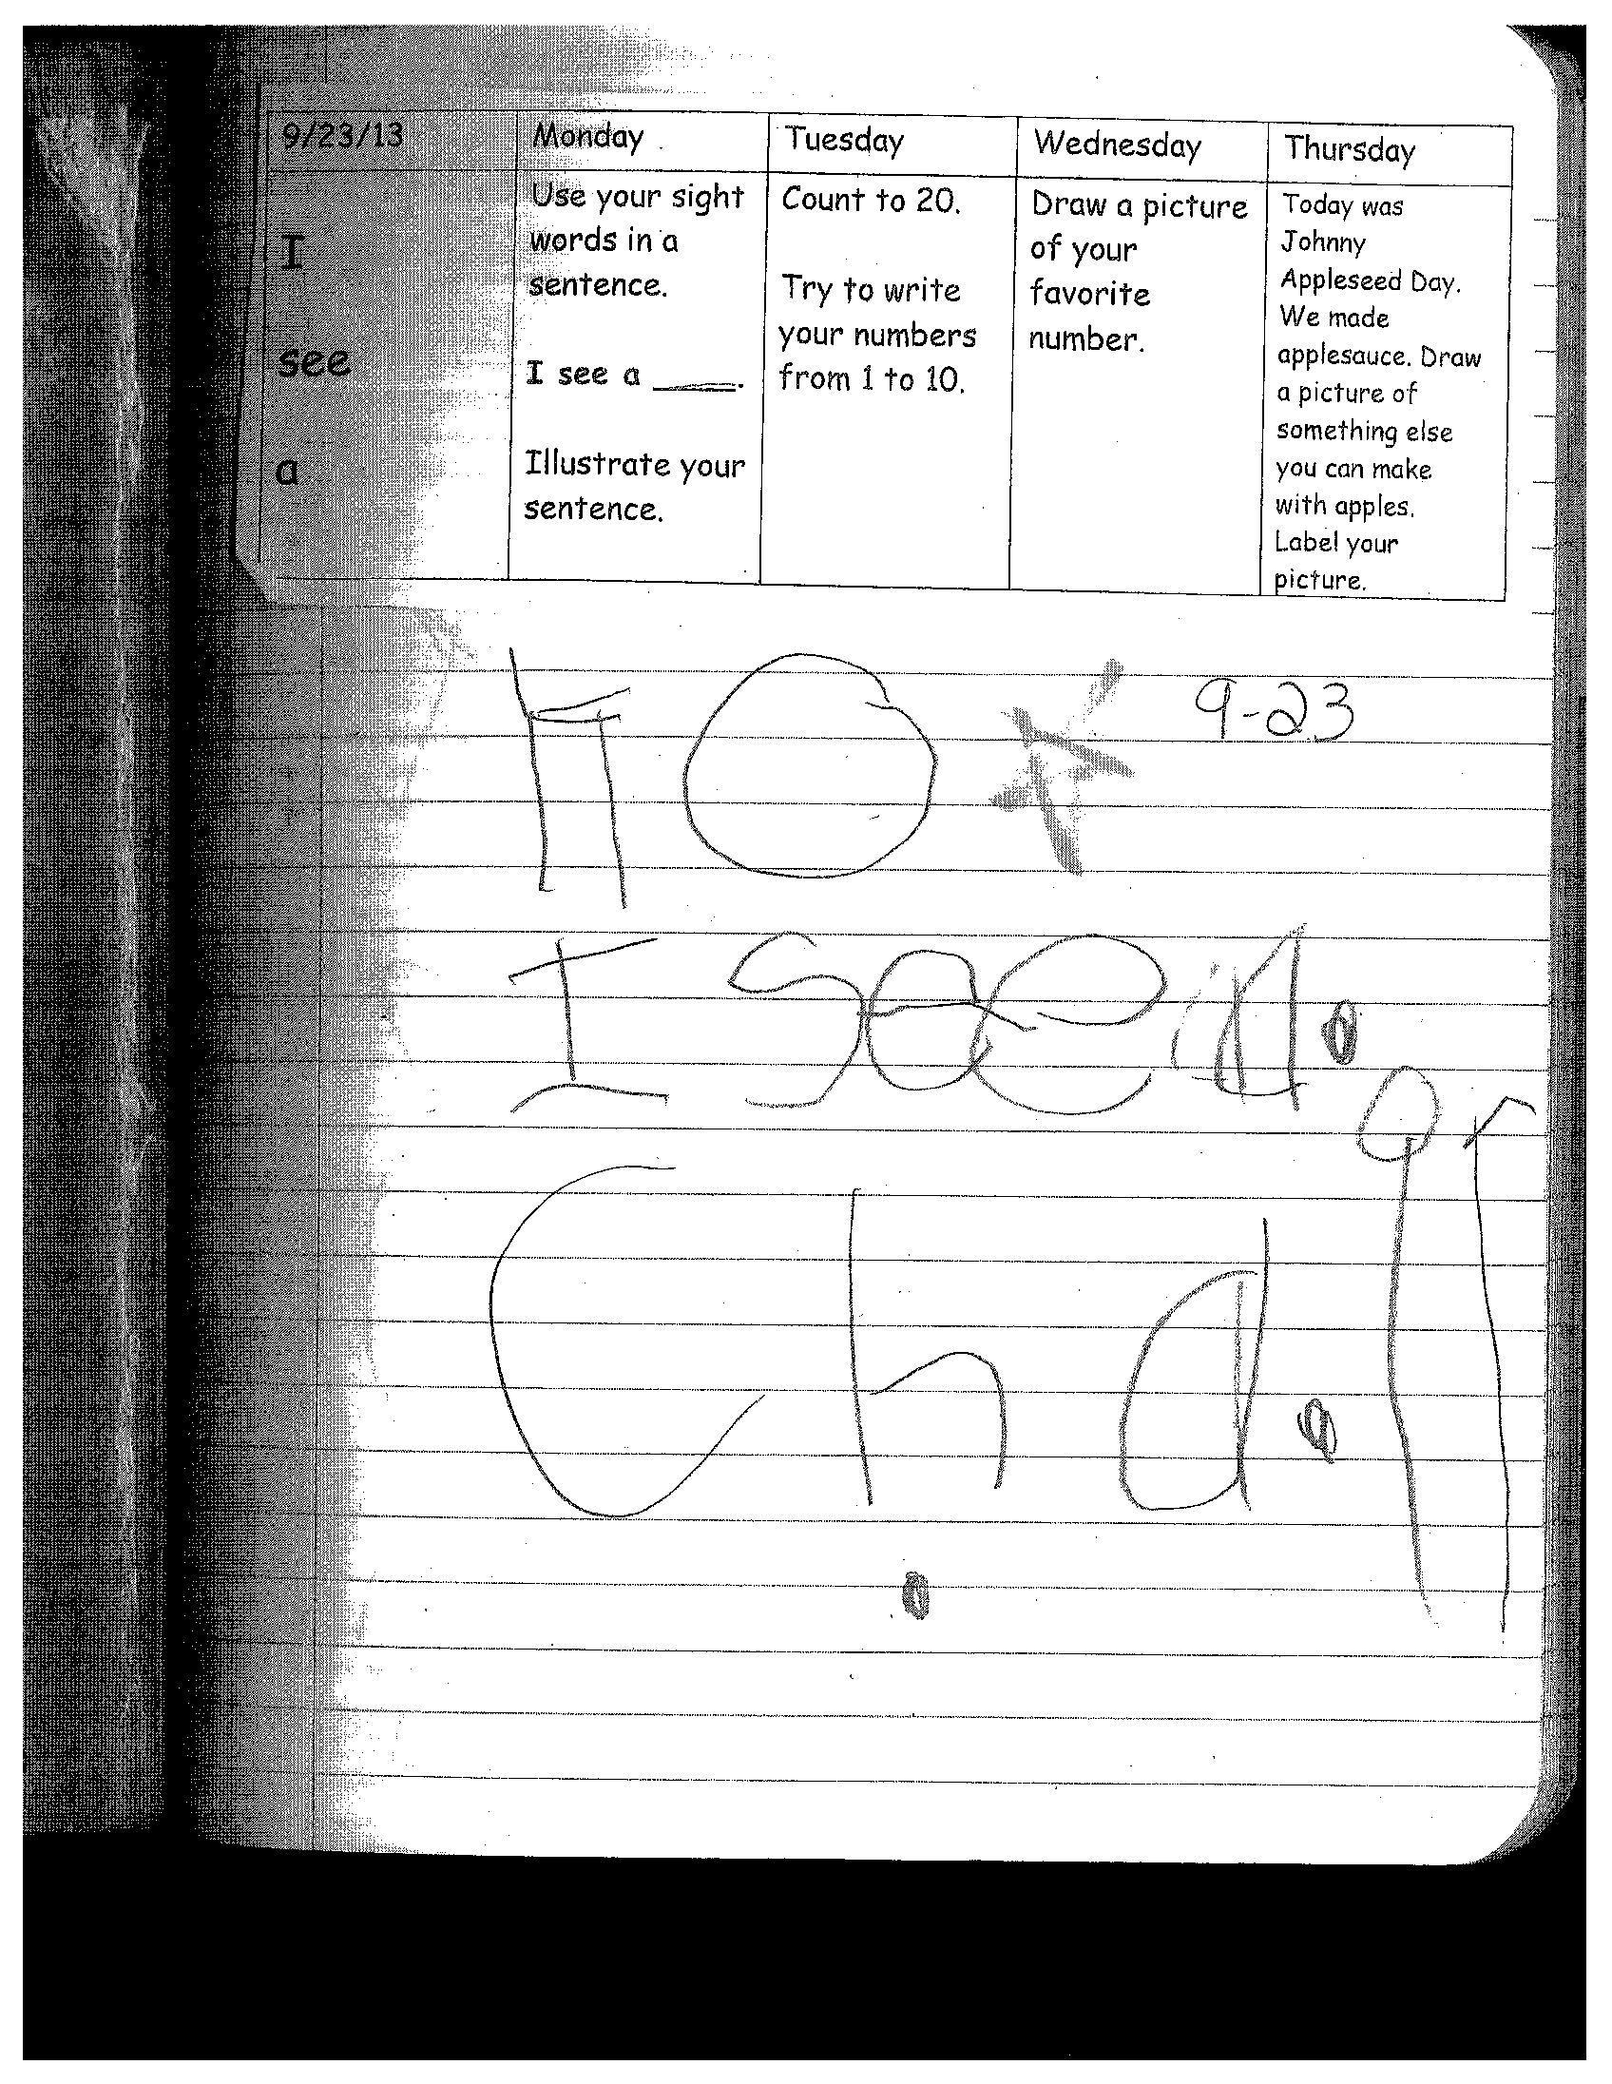
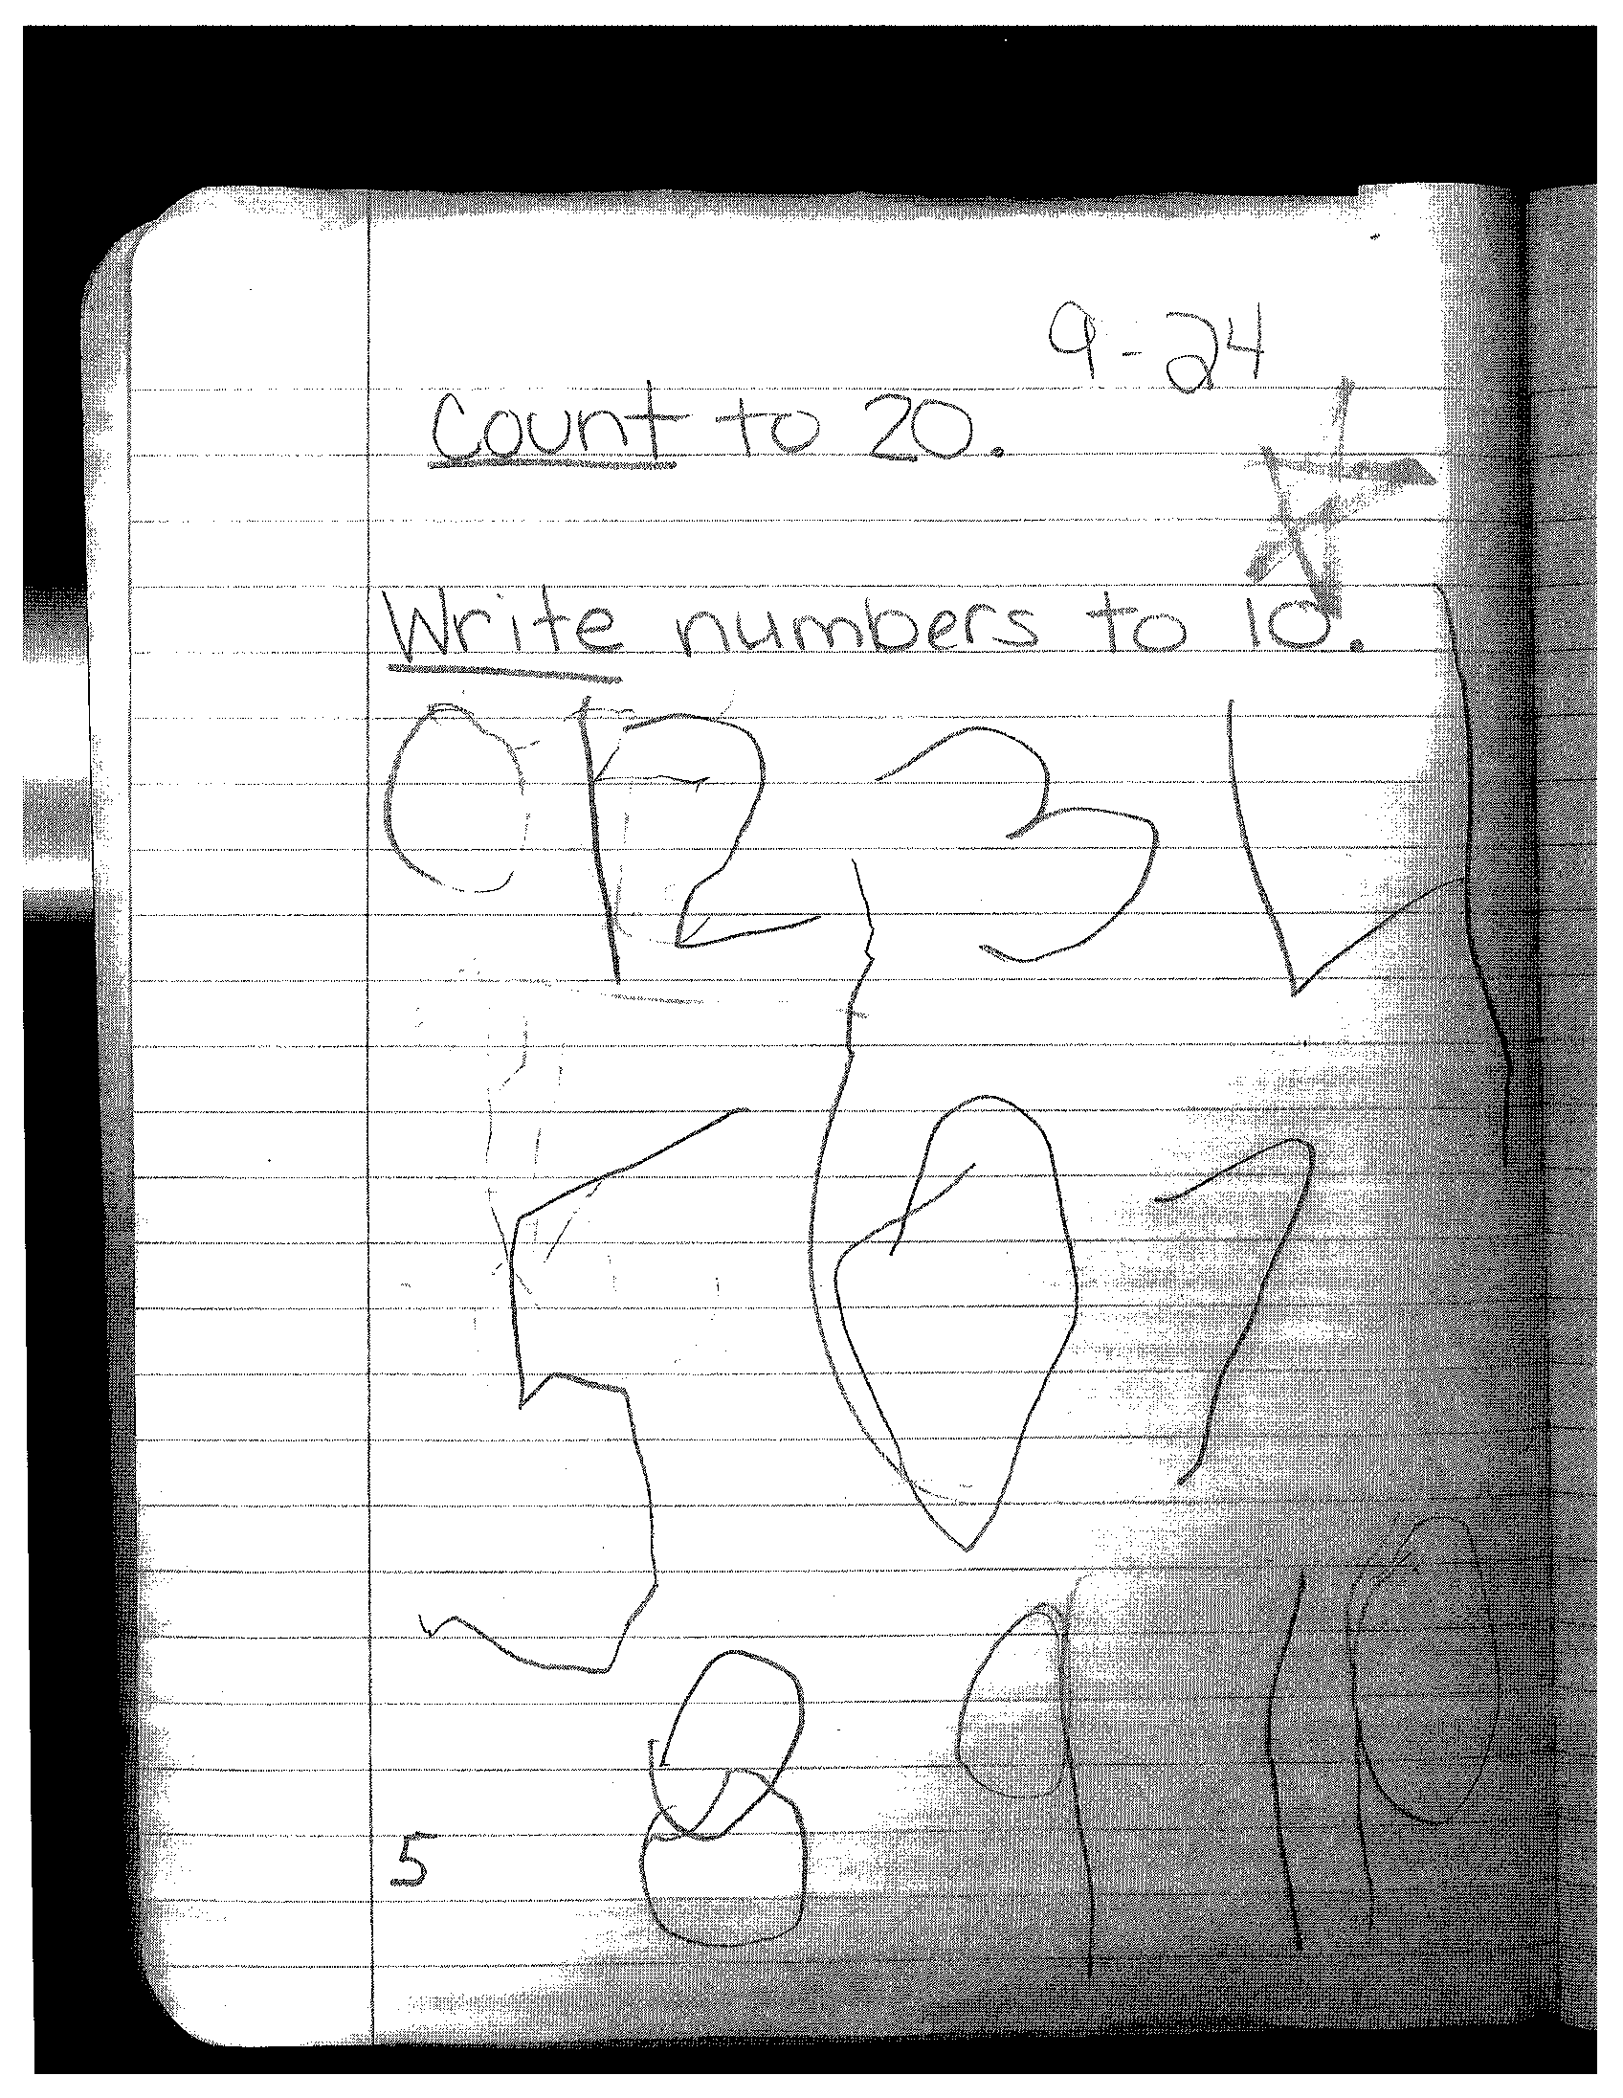

Slide 21
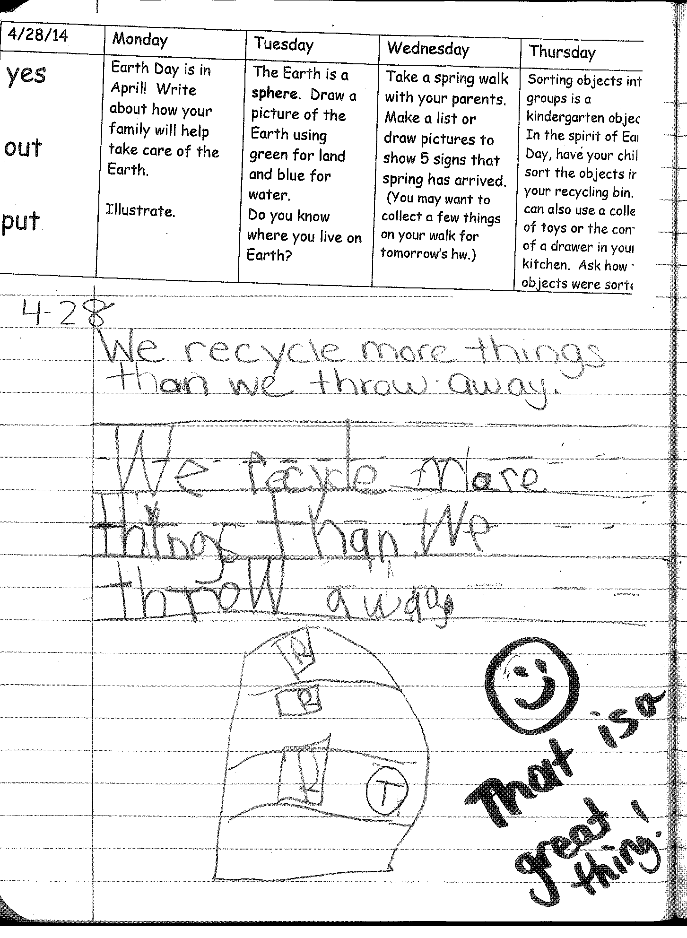
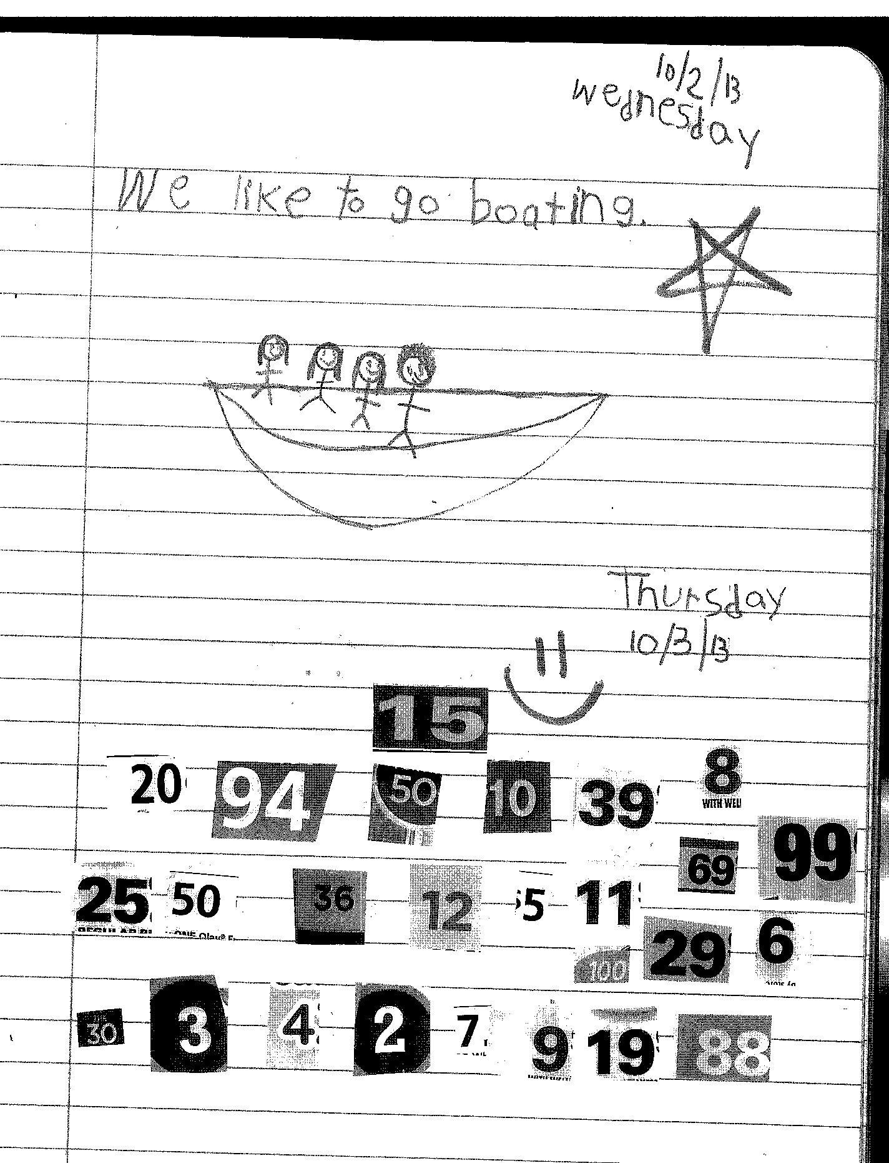

Slide 22
Field Trips
Walk to Savage Library
Farm
Firehouse will visit
Animal Lady will visit
Parent chaperones will be chosen with a lottery system.
Volunteer Training for Chaperones

Slide 23
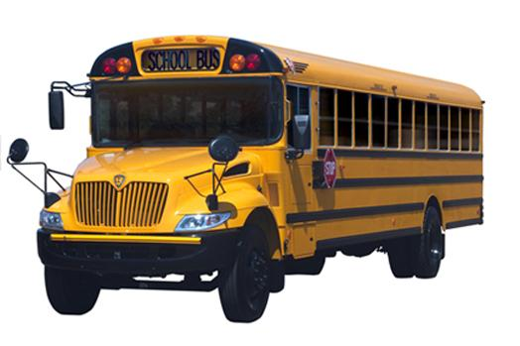
Transportation
We will only change your child’s transportation home with a note from you!
We will not just follow what your child says without confirmation from you!
(Please don’t rely on same day emails. Call the office in an emergency.)

Slide 24
How was your day? - “Fine.” What did you do? – “Nothing…”
ASK SPECIFIC QUESTIONS
Did you work with numbers/ letters/words today?
What story did your teacher read? Tell me about it.
What made you happy today? sad, excited, frustrated…
Who did you sit with at lunch?
Who did you play with at recess? What game did you play?
What teachers did you see today?
What did you do today that you were proud of?
How did you work with your friends today?

Slide 25
Donations are wonderful!
Hand sanitizer
Baby wipes
Dixie cups
Tissues
Ziploc bags
Index cards
Post-it notes
Look for notes to come home asking for supplies to replenish current supplies.
Glue Sticks
Crayons
Science Curriculum
Cardboard tubes
Broken-down cardboard boxes

Slide 26
Pack an Extra Set of Clothes
Accidents can happen.
It is much better to be prepared!
Please pack a set of clothes including underwear in a small bag in your child’s backpack.
Remember to send weather appropriate clothes as the seasons change.

Slide 27
Classroom Volunteers!
Complete the training.
http://www.hcpss.org/parents/volunteer-information/

Slide 28
Childhood is a journey, not a race.

